Slide 1
Data Mining in politics
Group 19
Chun-I TSAI
Inho CHOI
Lim Kévin CHAO

Slide 2
Contents
Introduction
Method to define a vote
Attributes and solution
Experimental setup and results
Conclusion

Slide 3

Introduction
Could Data Mining on 1990 US census have helped in the prediction of president election of 1992 ?
Voting is one of the most essential issues of politics.
Poll is a common way to predict result of voting, but it fails to detect easily.
We explore a way to predict or benefit polls for president election in 1992 by leveraging US census in 1990.

Slide 4
Method to define a vote
Although there are many influencing factors affect person’s willing to vote which party, we make a simple assumption as below:

Slide 5


Method to define a vote
Although there are many influencing factors affect person’s willing to vote which party, we make a simple assumption as below:
☑Ruling party
□Opposition party
□Ruling party
☑Opposition party

Slide 6
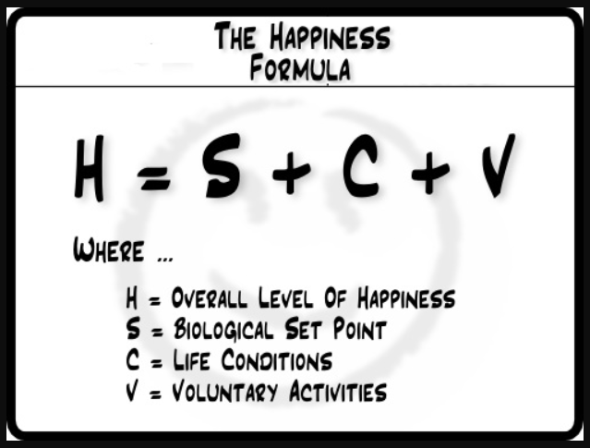
Attributes: about Happiness
Numeric |  | Nominal
AGE HOUR89 HOURS POVERTY REARNING YEARSCH |  | CLASS DISABL2 FERTIL INDUSTRY MIGSTATE OCCUP RSPOUSE
References : https://www.slideshare.net/ESMT/the-quest-for-happiness

Slide 7
The solution: clustering
K-means Clustering : K=2, MixedMeasures
- Prediction : If the bigger cluster is happier, the ruling party will win in that state.
- MixedMeasures : We use Numerical and Nominal type data at the same time.
Euclidean distance for numerical and nominal values.
For nominal values, a distance of one is accounted if both values are not the same.
Notes:
Our solution for the election prediction is K-means Clustering. The logic of our prediction is like this : If the bigger cluster is happier, the ruling party will win in that state because they more likely to vote for ruling party.
To do that, we configured the value of k as 2 and used MixedMeasures measure type.
The reason why we used MixedMeasures is that we have numeric and nomial type of data both.
Under the MixedMeasures way, for nominal values, a euclidean distance of one is accounted if both values are not the same.

Slide 8
Experimental setup and results
Data Set: a mix of numerical and nominal attributes from the dataset generated from the US census of 1990.
2,468,284 people
68 attributes
Statistics of people in a state: Average: 20433, Max: 111419, Min: 1433
Notes:
The data set that we used is a mix of numerical and nominal attributes from US census of 1990.
There are about 2500000 respondents and 68 attributes.
The average of the number of each state is about 20000.

Slide 9
Experimental setup and results
Pre-processing:
Dimensionality reduced by keeping essential attributes manually
68 → 13 attributes
Only analyzing people have right to vote (age > 18 & is a citizen)
2,468,284 → 1,723,531 people
Scaling nominal attributes with too many categories
Normalizing Numeric attributes by z transform and range transform
Transfer YEARSCH to the numeric type (e.g. master = bachelor + 2, Ph.D. = master + 5)
Notes:
In order to predict more clearly, we pre-processed the original census data.
First, dimensionality was reduced by keeping essential attributes manually. Many attributes not related with happiness that much were eliminated.
Second, only analyzing people have right to vote. People who cannot vote are meaningless in this prediction.
Third, scaling nominal attributes with too many categories.
Fourth, Normalizing numeric attributes by z transform and range transform.
Last, Transfer YEARSCH to the numeric type to differentiate the gap between each degree.

Slide 10
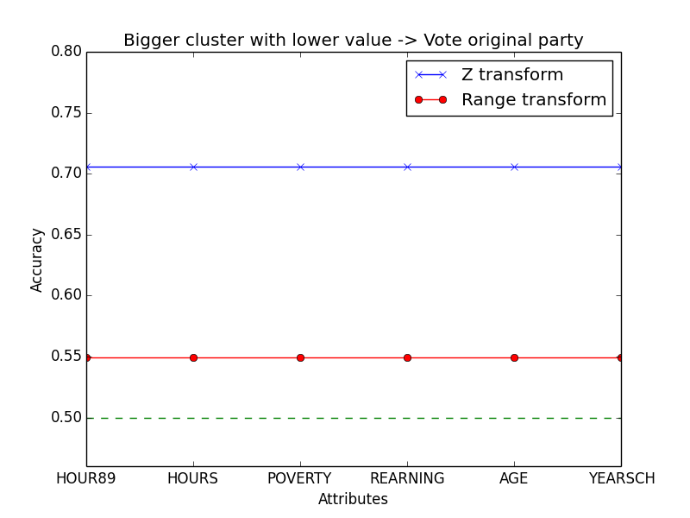
Experimental setup and results

Slide 11
Experimental setup and results
Ideal
not Ideal
Unexpect

Slide 12
Experimental setup and results

Slide 13
Experimental setup and results

Slide 14
Experimental setup and results

Slide 15
Conclusion
Happiness has effect to which party people prefer more, but need to find a correct attribute to judge.
Different kind of normalization have consistent results.
Find a way to use multiple attributes (including nominal type) for our prediction.

Slide 16
Conclusion
With small resources we have managed to find some correlation from data of the 1990 census that could have helped in the prediction of the US president in 1992.

Slide 17
THANK YOU!
ANY QUESTIONS ?

